Slide 1
ArcZone
A retro arcade app
Riley Lawson, Cody Draper, Ryan Cook

Slide 2
Required Functionality
Title screen
Login page/User profile with data backend using either SQL, MongoDB, or Firebase
Save scores if you are logged in but still allow guest play
Leaderboards for each game
Game selection screen
Game preview/about/rules/faq
Settings screen / pause menu / difficulty scaler
3 games

Slide 3
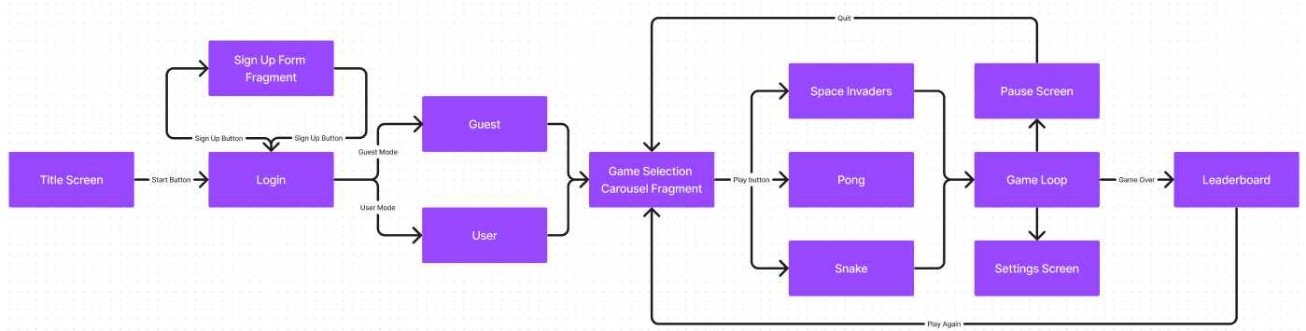
Activity Map

Slide 4
Front End - Login Operations
Designed using MVC pattern - Controller handles all logical functions
Uses a mix of Fragments and new Activities
Uses Glide Library to load .gifs into ImageView objects for animated backgrounds/Images
Uses Animation class to animate transitions on the login operations activities such as fade in and fade outs
Uses a Dialog fragment for register pop up

Slide 5
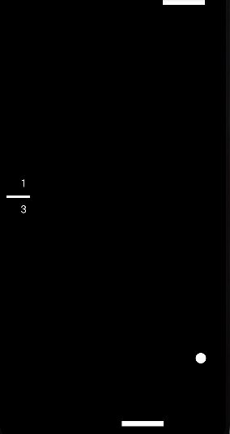
Game 1
Pong
Includes an AI opponent that’ll face you in a ball battle
A loop that runs through updating the ball speed, collisions, score, gameover, “AI” movement, and ball movement.
Game over at 10 points

Slide 6
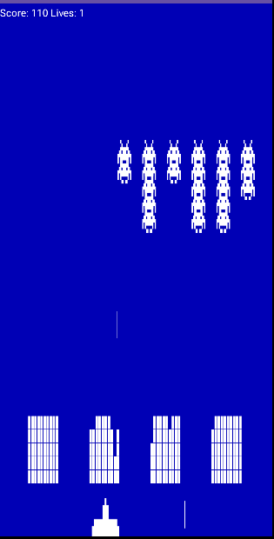
Game 2
Goal of the game is to shoot all the Invaders which gives 10 points a kill.
Uses a while loop to constantly check the games update method which includes.
bullet hits
visibility of invaders, bullets, and defending walls
Whether the game is over or if you lost
etc.
The way the game ends is you either lose all your lives, the invaders reach the bottom, or you destroy all the invaders in which the next level starts.
Space Invaders

Slide 7
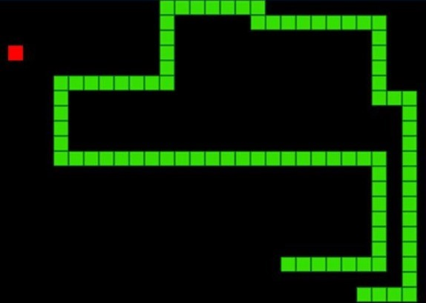
Game 3
Snake moves through the screen collecting “Apples” and growing on each successful collection
Implemented with Canvas
Map is the size of the device screen
Update is called every 10 FPS to update the positioning
Draw is called to update the UI
Touch input moves the snake
Game is over when you hit a wall or hit yourself.
Snake

Slide 8
Back End
Uses Firebase Auth to authenticate users
Uses Firebase Firestore Database to store User data and High Scores
Two Collections: Scores and Users
Users
Used to store user data in a global user object implemented a singleton design. This allows all user data to be accessed by all activities without having to pass the data via intents or query the database more than once for user data.
Holds: username, email, password, and top Scores of player for each game
Scores
Used to store the top ten scores for each game.
Holds the score and username associated with it.

Slide 9
Yet to Be Implemented
Games need to be polished and connected to the front end
Games need methods for changing sound and difficulty variables in game settings.
Settings Overlay needs to be fixed
Leaderboard page needs to be designed and connected
Pause menu, difficulty scaler, and setting screen

Slide 10
Demo

